Slide 1
Hedy Lamarr
Théa & Emily

Slide 2
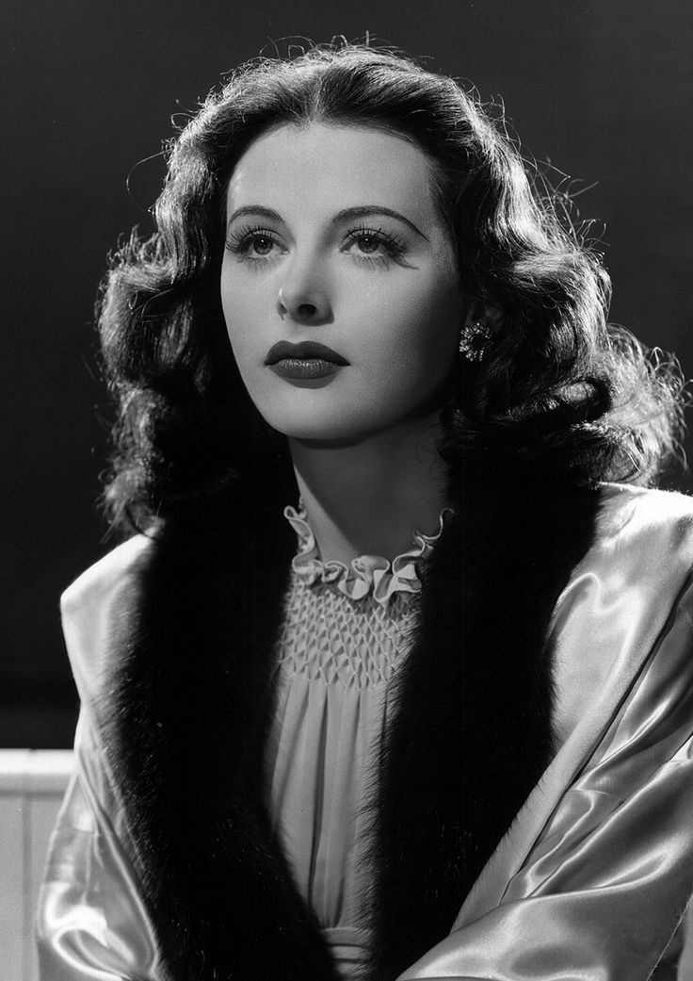
She was described as the most beautiful woman in Hollywood, she made her way through life thanks to her beauty, but nobody would suspect that this Austrian born star had the brains of a world class inventor, she inspired Disney Snow White and invented the technology that would later enable Wi-Fi and Bluetooth today. it’s the story of Hedy Lamarr.

Slide 3
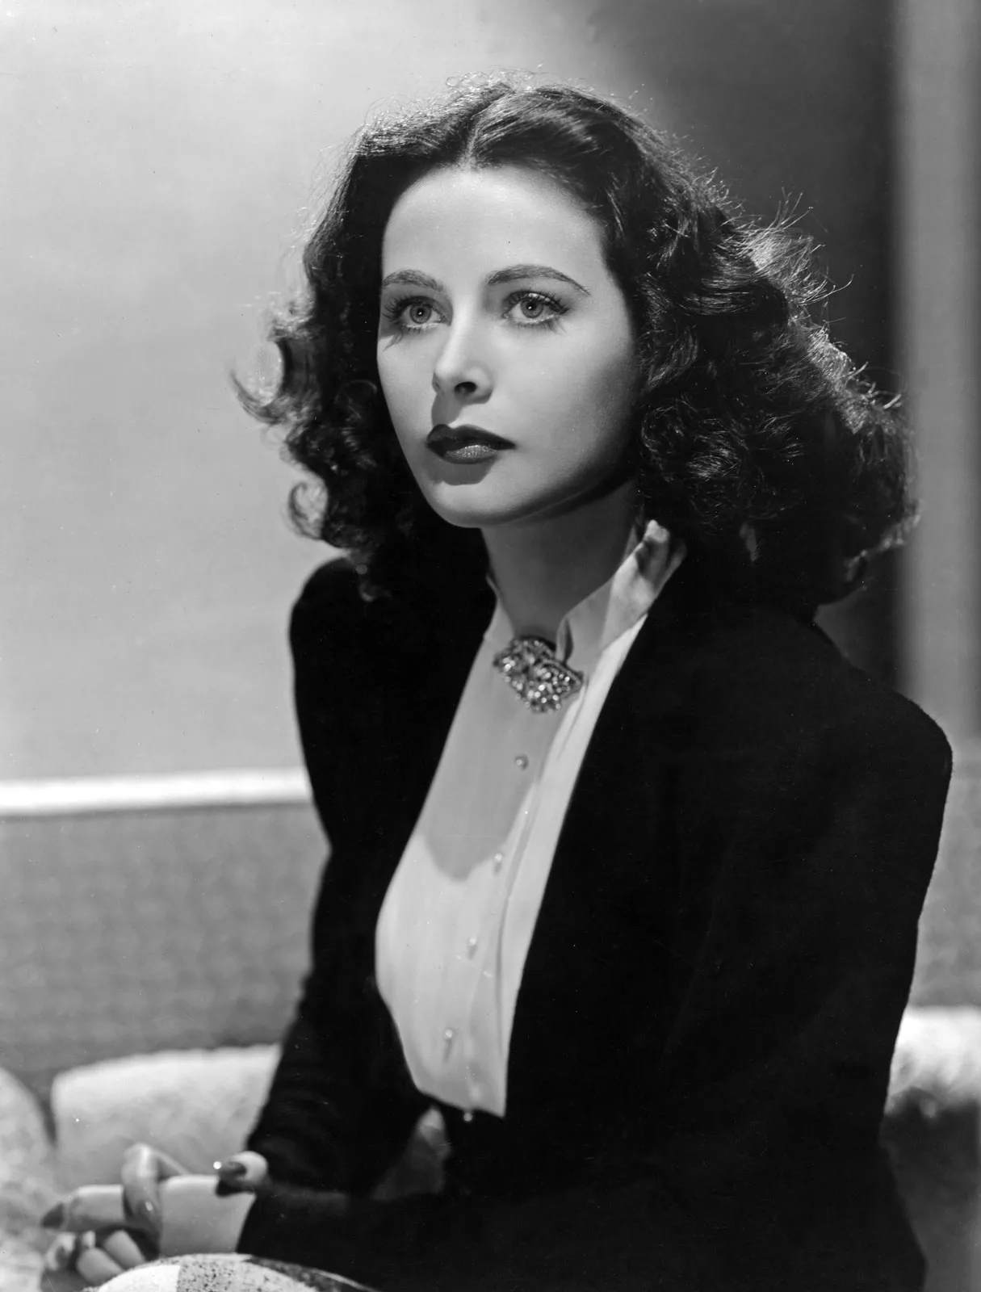
The actress later known as Hedy Lamarr was
born as Hedwig Kissler on november 9, 1914
in Vienna. Her parents were able to provide
her with the best education and introduced
her to classical music theater and the arts
in general. She was enrolled in one of
the best schools in the Austrian capital.
Her father was supportive of her early
engineering skills but most of all Hedy
was conscious of her beauty and how she
would turn heads wherever she went.

Slide 4
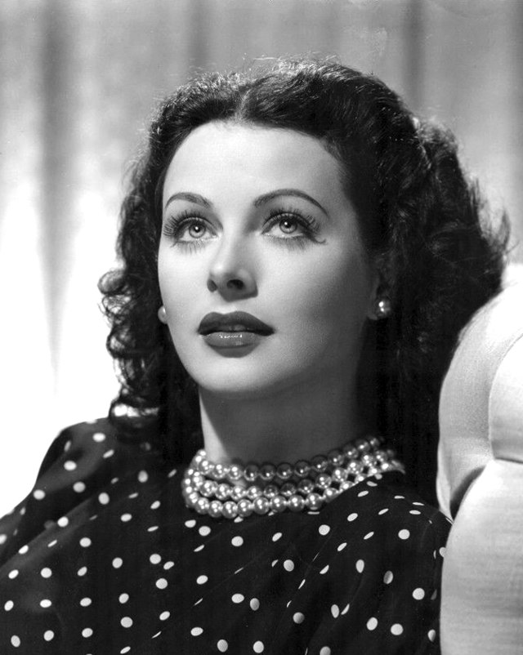
Hedy interred a beauty contest at only 12, but her parents were not amazed by this so their solution was to lock her up in a Swiss boarding school, but Hedy slipped back to Vienna after demanding her father to go back there, and yet after that she attended another pageant contest. Hedy took her first steps to stardom, first she signed up for acting classes then got herself a job as a script writer at Austria’s largest movie production company. Then she left school to work, and her 1st role was a secretary and the film premierd in 1930.

Slide 5

With her first success she grabbed the attention of some producers. After being named as the most beautiful girl in the world in 1931, Hedy got herself more job offers in the cinematic world which led her to move to Berlin and shoot two films, but with the rise of the power of the Nazi party she moved back to Vienna and she got hired by Czech director Gustav Mahati to act in a film that would set Europe ablaze with controversy Ecstasy.

Slide 6
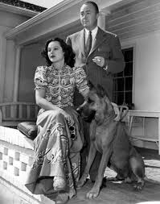
Hedy and her parents got harassed by Fritz Mandel who came from a wealthy Hungarian family and he demanded an engagement and then got married on the 10th of august 1933.
Right after that he started getting jealous and he demanded that Hedy quit acting and that every print of Ecstasy would be bought and destroyed.
Mandel locked up Hedy in his own version of Rapunzel’s tower in which she had no interaction with the outside world. Hedy had tried several times to escape her husband’s prison but it was never a success.

Slide 7
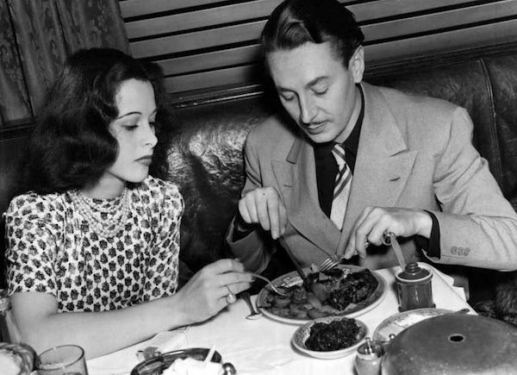
In early 1937 Hedy hired a lookalike named Laura and gave 3 sleeping pills so she could use Laura’s car to escape to the nearby train station and hopped on a train for freedom. Her experience with Fritz had not been entirely negative, she was supposed to play the role of a trophy
wife at business gatherings and she
enjoyed discussing
technical details with Fritz’s
colleagues especially engineers.

Slide 8
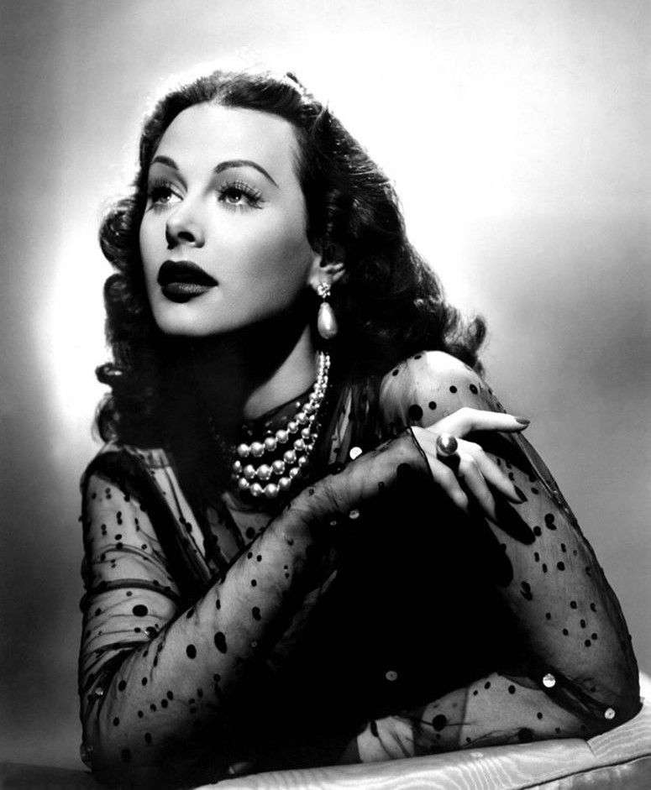
What everybody has overlooked so far is that Ms Kissler may have frequently skipped school but when she was in class she excelled at science, her propensity for experimenting and inventing would later pay off in a rather unexpected way. The Mandel’s marriage was dissolved years later when Hedy obtained a divorce in Nevada.

Slide 9
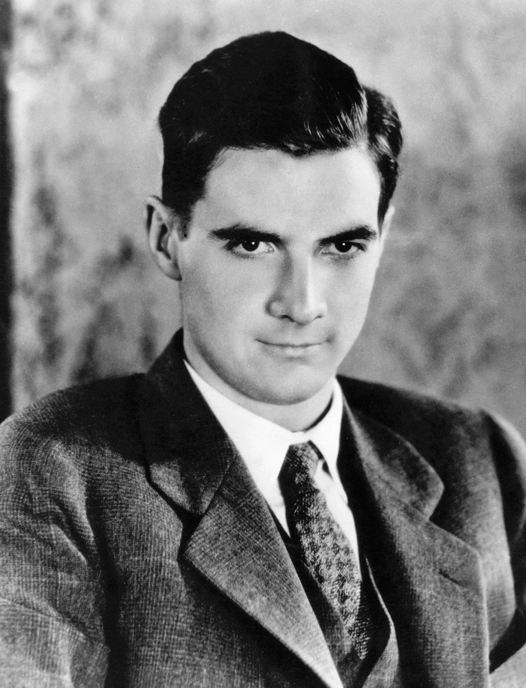
After signing a contract with Meyer’s film studio this would be the point where she would adopt her stage name and leave her old Austrian name behind. Hedy Lamarr was often referred as the beautiful and exotic lady in town and her name also started getting associated with some of the most famous men of her time as well. One of these eligible bachelors was the wealthy business tycoon and pilot Howard Hughes. Hughes and Lamarr dated, but instead of being attracted merely to his wealth and prestige, Hedy was more interested in his desire of innovation. Her interest in the science, which her father helped cultivate, had been repressed by her Hollywood career, but Hughes helped reignite the flame within her mind.

Slide 10
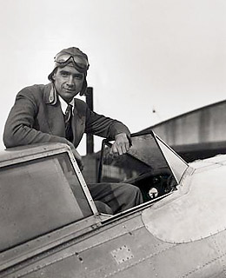
He gave her a small set of scientific lap equipment that she would use in her trailer while on the sets of her films. Knowing that she had a passion for engineering, Hughes took her to his airplane manufacturing facilities and gave her a behind-the-scenes look at how these aircraft were built while introducing her to scientists and engineers.
Lamarr was very inspired by all of this and was especially intrigued by Hughes’s desire to create faster planes that could be marketed to the US military. After buying a book covering birds and fish, she took that knowledge and crafted a new kind of wing design for Hughes airplanes. After she showed her work to Hughes, he declared her to be a genius.

Slide 11
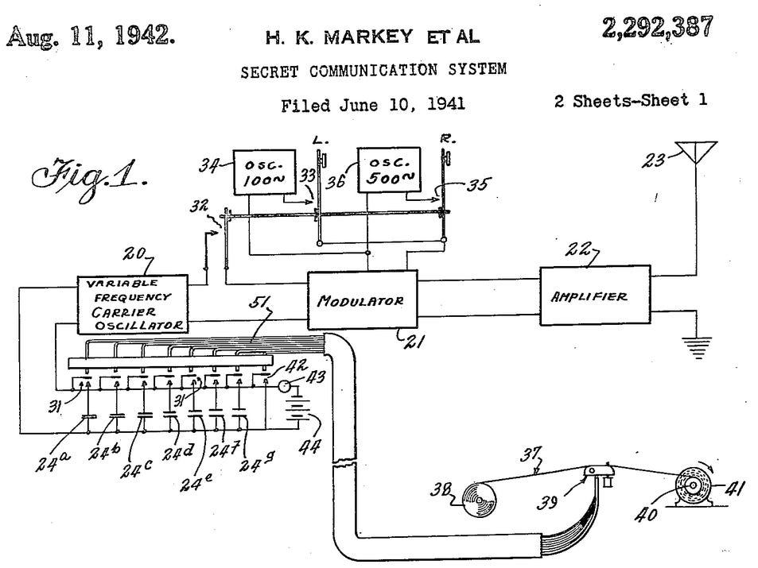
A genius she was, in 1942,
at the peak of her Hollywood career, she met a composer named George Antheil at a dinner party. Antheil and Lamarr would hit it off and started to swap invention ideas, as they both shared interest in science and technology.
Eventually, they were awarded a patent in august 11, 1942, for a novel type of radio signaling device called a ‘secret communications system’ which used an ever-changing set of radio frequencies to keep enemy intelligence operatives from decoding covert messages.

Slide 12
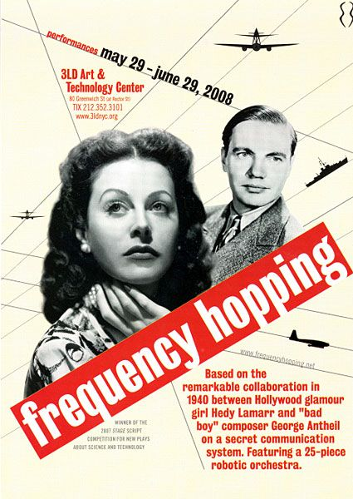
Originally this tech, which was technically called a
frequency-hopping spread system, was designed to outwit the Nazis by guiding allied torpedoes in WW2.
Later this system would become a crucial stepping stone in the development of technology for both military
communications systems as well as cellular
phones.
Eventually, this tech would give rise to
technologies such as WI-FI, GPS, CDMA,
and Bluetooth.

Slide 13
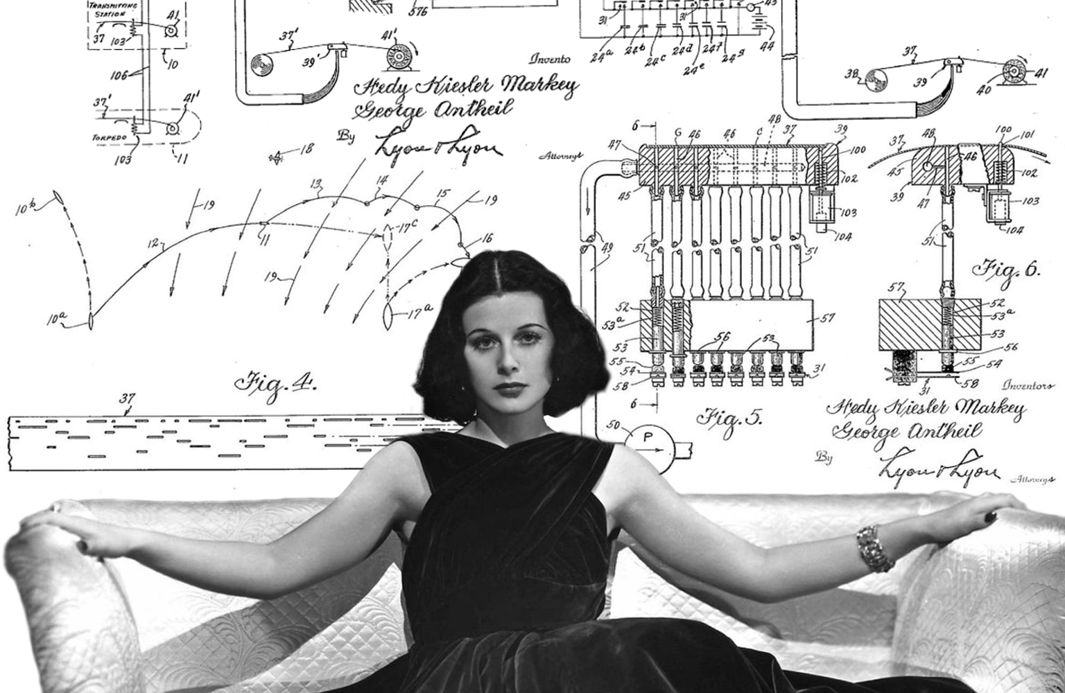
Since this wide range of applications of tech wouldn’t be understood fully until
decades later, Lamarr and
Antheil sadly wouldn’t get
the recognition that they
fully deserved, in fact,
it would be many
years later until anyone
outside of the military knew
what they had developed.

Slide 14
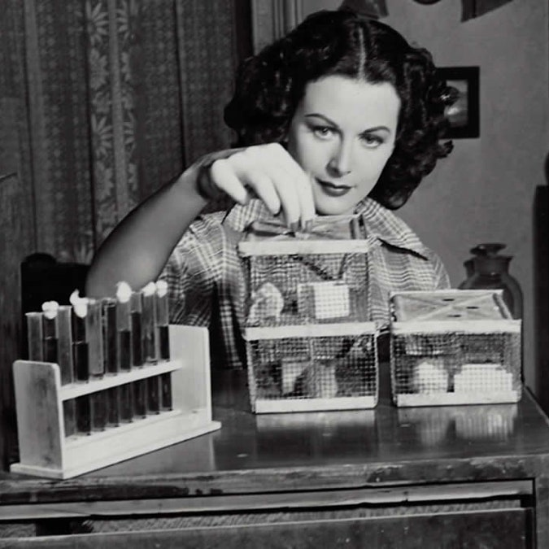
What Lamarr and her cohort had presented to them was so far advanced and beyond their comprehension, that the military didn’t even know what to do with it.
Two decades later, however, an updated version of Lamarr and Antheil design began to appear on navy ships during the time of the Cuban missile crises.

Slide 15
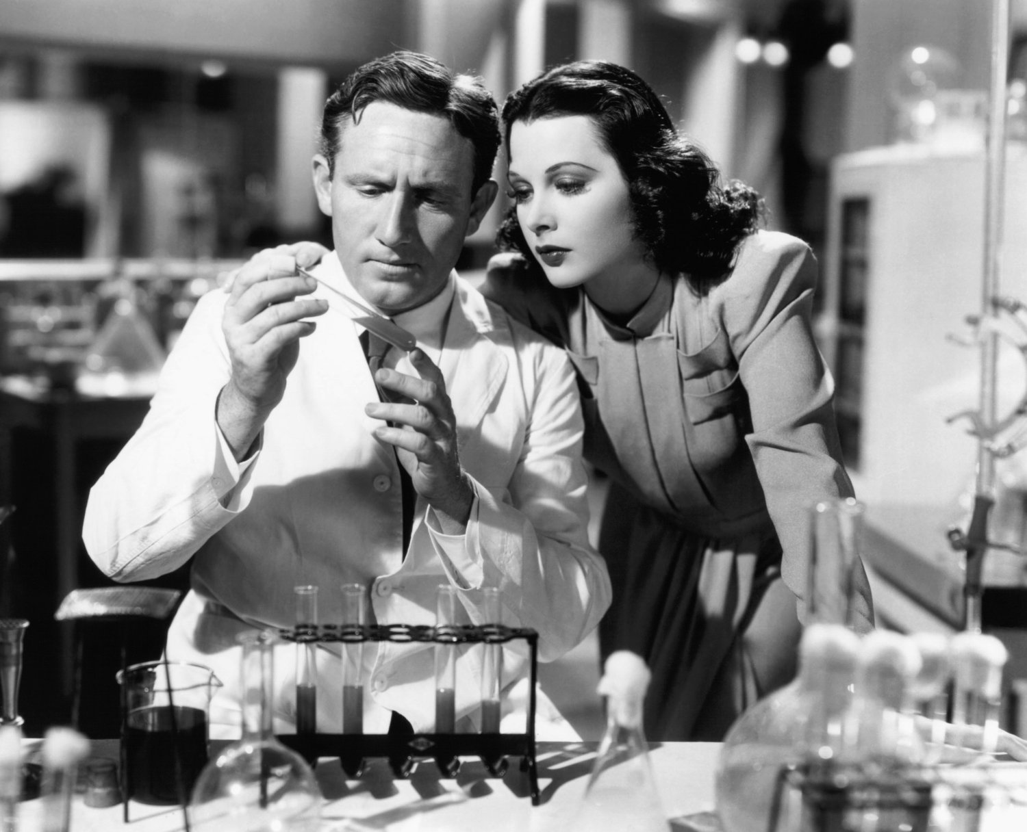
It wasn’t until 1997 that Lamarr was honored with the electronic frontier foundation pioneer award. That same year, she would also become the first woman to receive the BULBIE Gnass spirit of achievement award – an honor that is often regarded as the Oscar award of inventing. In 2014, Lamarr and Antheil were inducted into the national inventors Hall of Fame. Lamarr’s later film career, seven years after inventing the tech that would eventually earn her the nickname of ‘the mother of the Wi-Fi’.

Slide 16
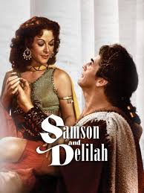
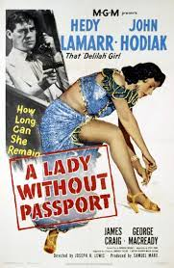


Lamarr appeared in her most successful Hollywood film, in the 1949 biblical drama ‘Samson and Delilah’. the film ended up winning two Oscars and scored big marks with critics. Lamarr would go on to appear in films like 1950s ‘A Lady Without Passport’ which ended up being a flop, and the more successful films ‘Copper Canyon’ and ‘My favorite spy’, which respectively hit theater in 1950 and 1951

Slide 17
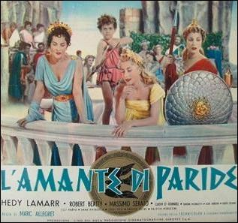

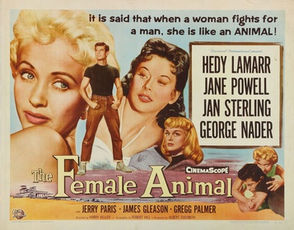
Her film career began to decline, after trying her hand out as a producer and playing multiple roles in 1954s ‘loves of three Queens’, she ended up losing millions of dollars when the project failed to impress critics and audiences alike. In 1955, she played Joan of Arc in the film ‘the story of Mankind’, yet another commercial flop. Her last film was the 1958 thriller ‘the female animal’.

Slide 18
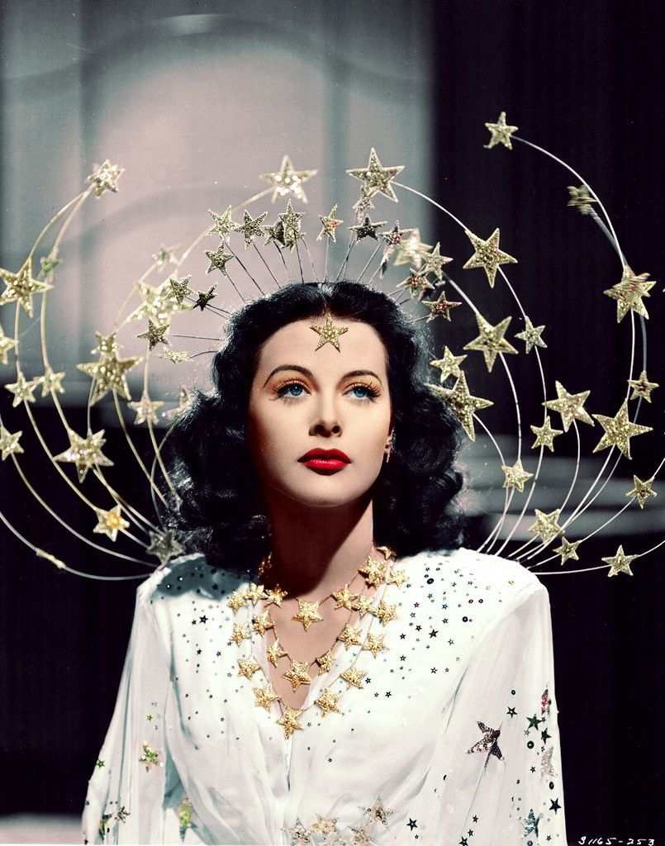
In 1981, after her eyesight had begun to fail, Lamarr retreated from the spotlight and settled in Miami Beach, Florida. In 1991, she was arrested in Florida for stealing $21.48 worth of eye drop and lexatives.
For the last few decades of her life, Lamarr continued to live in seclusion with her only connection to the outside world being the telephone.

Slide 19
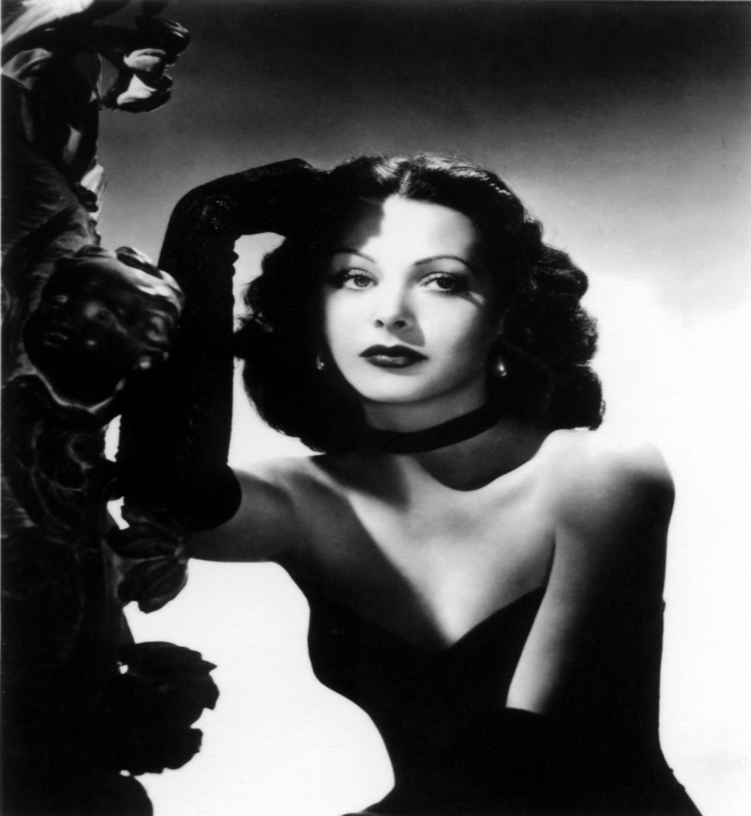
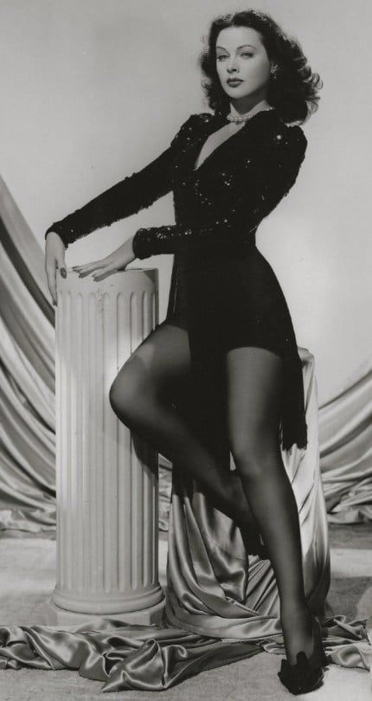
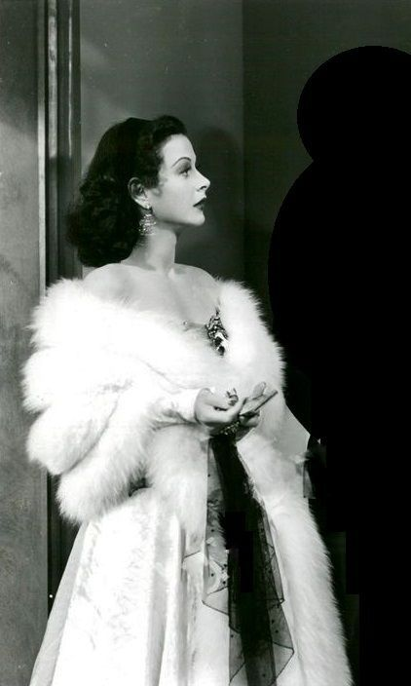
On January 19, 2000, Hedy Lamarr died in Casselberry, Florida, due to a heart disease at the age of 85. And that’s the story of ‘the mother of the Wi-Fi’.

